Slide 1
PREPOSITION
Mamunur Rashid Zaber
Lecturer
Green University Language Center
Department of English, GUB

Slide 2
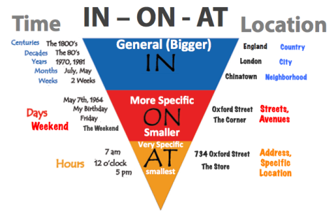
Prepositions

Slide 3
Prepositions
In
On
At

Slide 4
Prepositions
Place
Time
Others

Slide 5
Prepositions
In: for Place
in for an ENCLOSED SPACE
in the garden
in my wallet
in a box
in London

Slide 6
Prepositions
In for time
in for MONTHS, YEARS, CENTURIES and LONG PERIODS
in May
in summer
in 1990
in 1990s
in the next century
In in the Ice Age

Slide 7
We also use In to…
Indicate a shape, color, or size:
This painting is mostly in blue.
The students stood in a circle.
This jacket comes in four different sizes.
Express while doing something:
In preparing for the final report, we revised the tone three times.
A catch phrase needs to be impressive in marketing a product.
Indicate a belief, opinion, interest, or feeling:
I believe in the next life.
We are not interested in gambling.

Slide 8
Prepositions
on for place
on for a SURFACE
On the wall
On the ceiling
on the door
on the menu
On a page
On the table

Slide 9
Prepositions
on for time
on for DAYS and DATES
On Sunday
On Mondays
On 6 March
On 25 Dec. 2010
On Christmas Day
On New Year's Eve

Slide 10
We also use On to…
Indicate a device or machine, such as a phone or computer:
He is on the phone right now. She has been on the computer since this morning. My favorite movie will be on TV tonight.
Indicate a part of the body:
The stick hit me on my shoulder. He kissed me on my cheek. I wear a ring on my finger.
Indicate the state of something:
Everything in this store is on sale. The building is on fire.

Slide 11
Prepositions
at for place
at for a POINT
At the corner
At the bus stop
At the door
At the top of the page
At the entrance
At the front desk

Slide 12
Prepositions
at for time
at for a PRECISE/TINY TIME/VERY SMALL
At 3 o'clock
At 10.30am
At noon
At bedtime
At sunset
At the moment

Slide 13
Prepositions
Used to indicate an email address:
Please email me at abc@defg.com
Used to indicate an activity:
He laughed at my acting.
I am good at drawing a portrait.

Slide 14
Let’s Practice
Dinosaurs lived ____the ancient time.
I & my wife were sitting ___ one corner of sea shore.
He was born ___ 25th December ___ 1975.
It rarely snows ____ winter ____ Bangladesh.
He put the bag ____the table.
He is ___the room. But he is sitting ___ the corner.
He’s standing ____ the entrance of the cave.
Our university remain closed ____ Sundays & Mondays.
After taking bath ___ the sea, we’re relaxing ____ the resting chair ____ the sea beach.
We’re practicing prepositions ___ this moment. ___ 28th January, we’ll talk about Conditionals.

Slide 15
Solutions…
Dinosaurs lived __in__the ancient time.
I & my wife were sitting __at_ one corner of sea shore.
He was born __on_ 25th December __in_ 1975.
It rarely snows __in__ winter __in__ Bangladesh.
He put the bag _on_the table.
He is _in_the room. But he is sitting _at_ the corner.
He’s standing __at__ the entrance of the cave.
Our university remain closed __on__ Sundays & Mondays.
After taking bath __in_ the sea, we’re relaxing sitting__on__ the resting chair __at__ the sea beach.
We’re practicing prepositions __at_ this moment. _on_ 28th January, we’ll talk about Conditionals.

Slide 16
Thank you
☺ ☺ ☺

